Slide 1


The Power of Mentoring: Why Mentoring Matters Post-Pandemic and in the Age of AI
By: Antoinette L. Dunstan, Founding Executive Director
Property of: The First Ladies Youth Leadership Foundation, Inc.
@thenewfirstladies

Slide 2

FIRST LADIES’ MISSION
TO TRAIN AND EQUIP GIRLS AROUND THE WORLD TO BE POSITIVE GLOBAL CHANGE AGENTS AND TO DOMINATE IN THE TEN STRATEGIC CULTURES OF THE
NATIONS OF THE WORLD WITH STRENGTH AND DIGNITY.

Slide 3

12 Focus Areas
Faith/Purpose
Identity/Cultural Awareness
Building Healthy Families
Social Justice Awareness/
Civic Engagement/Community Service
Building Sisterhood
Mentorship
Leadership
Etiquette
High School Readiness
College Readiness
Career Readiness
Entrepreneurship
@FirstLadiesFdn

Slide 4

FACT
There is a mentoring gap in America.
1 in 3 young people will grow up without a mentor.
MENTORING.ORG
@FirstLadiesFdn

Slide 5
FACTS
Children in the United States are more likely to be exposed to violence and crime than adults. Each year, in America, millions of children are exposed to violence in their homes, schools, and communities as both victims and witnesses.
Youth violence is a global public health problem. It includes a range of acts from bullying and physical fighting, to more severe sexual and physical assault to homicide.
Youth violence has a serious, often lifelong, impact on a person's physical, psychological, and social functioning.
Worldwide some 200, 000 homicides occur among youth 10–29 years of age each year, which is 42% of the total number of homicides globally each year.
America is home to 5% of the population but has 25% of the world’s prisoners.
1 out of 4 human beings in the world are behind bars.
The U.S. has the highest incarceration rate in the world.
In 2020 NCMEC assisted law enforcement and families with more than 29,800 cases of missing children.
Case type: 91 % endangered runaways. 5 % family abductions. 3 % critically missing young adults, ages 18 to 20. Less than 1 % of nonfamily abductions. 1 % lost, injured, or otherwise missing children.
In one study, 3–24% of women report that their first sexual experience was forced.
In 2019, the FBI, stated that there were 421,394 NCIC entries for missing children. In 2018, the total number of missing children entries was 424,066.
Running away from home 1X decreases the likelihood that a youth will graduate from high school by 10%.
Running away from home 2+ times decreases the likelihood of completing high school by 18%.
@FirstLadiesFdn

Slide 6

Mentoring Outcomes
According to Mentoring.org, young adults who were at risk of falling off track because of not having a mentor, are now better positioned for success with the support of a mentor and are
130%
90%
More likely to hold leadership positions”
78 %
Are interested in becoming a mentor
55%
More likely to volunteer regularly
.
More likely to enroll in college
@thenewfirstladies
Notes:
According to Mentor.org

Slide 7
KEY DEFINITIONS
  Origin and History
  1740–50; Mentor (< Greek Méntōr)
A friend of Odysseus entrusted with the education of Odysseus' son, Telemachus when his father, Odysseus left for Troy.
The name appears to be an agent noun of mentos "intent, purpose, spirit, passion" from PIE *mon-eyo- (cf. Sanskrit man-tar- "one who thinks," Latin mon-i-tor "one who admonishes").
  Mentor [men-tawr]
(noun) Someone who teaches or gives help and advice to a less experienced and often younger person.
(noun) An influential senior sponsor or supporter.
(noun) A wise and trusted counselor, guide or teacher.
(verb) To teach, give advice or guidance to someone, such as a less experienced person or a child: to act as a mentor for someone.
  A mentor helps someone to learn and develop faster than they would otherwise do so. www.skillsyouneed.com/learn/mentoring.html
  Mentoring
  Mentoring tends to focus on the future, and broader skills for personal or career development, whereas a coaching relationship tends to focus on here-and-now. www.skillsyouneed.com/learn/mentoring.html
  Mentorship The influence, guidance, or direction given by a mentor.

Slide 8

“A mentor is not someone who walks ahead of you to show you how they did it. A mentor walks alongside you to show you what you can do. – Anonymous
BE THE DRUM MAJOR!
Founder & Executive Director
First Ladies Youth Leadership Foundation, Inc.

Slide 9
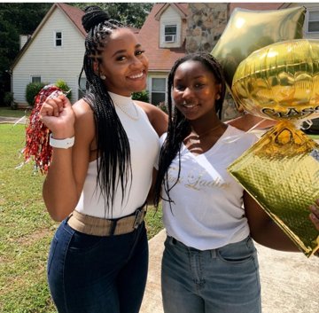
Be Part of Our Mentorship Team
Who Can Mentor?
  Working Professionals
  College Graduates
  Coaches
  Tutors
  Family Members
  Counselors
  Business Owners
  Educators
  Cross-Age Peers and many others
  PLUS YOU! You can provide mentoring to children and youth.
  YES…YOU CAN MENTOR!!!!!!!!!!!!!!
  “A mentor is someone who allows you to see the hope inside yourself.” Oprah
@thenewfirstladies

Slide 10
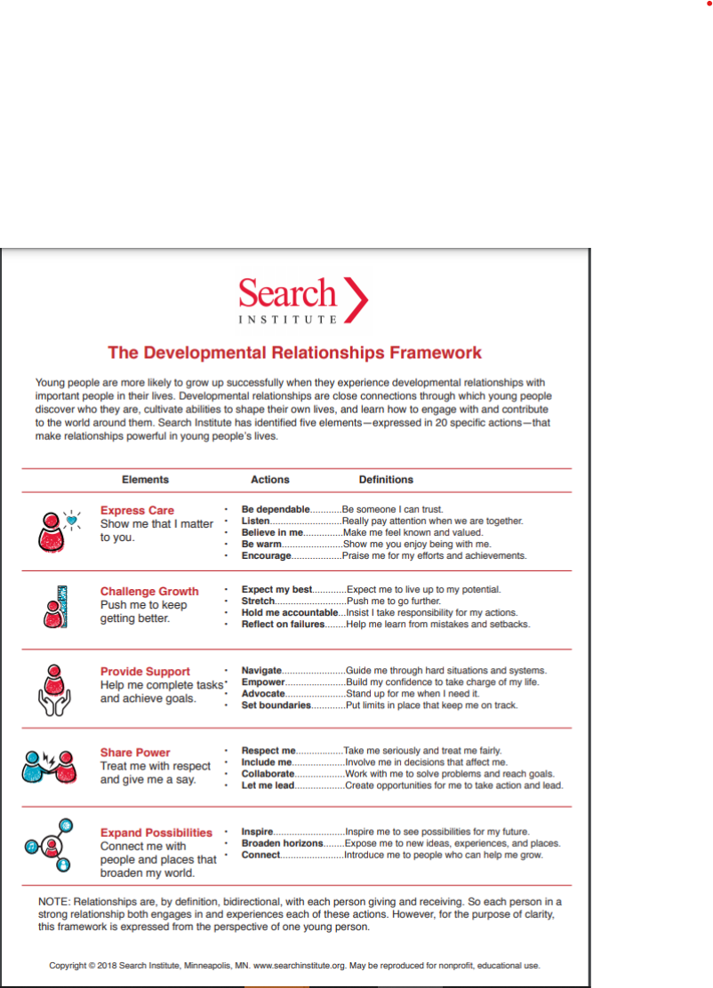

framework to
develop healthy
and positive
relationships
with first ladies
mentees

Slide 11

Mentorship, community & Education Works Hand-in-Hand
@FirstLadiesFdn
This Photo by Unknown Author is licensed under CC BY-SA

Slide 12


Commitment
21-Weeks
Monthly
4th Saturdays
Monthly
Mentor Team Check-Ins
Weekly
@FirstLadiesFdn

Slide 13

Non-Negotiables
1-Year Commitment |  | Integrity
 | Compaddion/ Passion
Collaboraton |  | Purpose Driven
SCHOOL
COMMUNITY
FAMILY
THE OUTCOME | SUCCESS
WEAK
MEDIUM
STRONG
@FirstLadiesFdn

Slide 14



“Show me a successful individual and I’ll show you someone who had real positive influences in his or her life. I don’t care what you do for a living—if you do it well I’m sure there was someone cheering you on or showing the way. A mentor.” —
Denzel Washington
@FirstLadiesFdn
Email: imentor@firstladiesyouthleadershipfdn.org

Slide 15

Contact Us
The First Ladies Youth Leadership Foundation, Inc.
950 Eagles Landing Pkwy.,
Suite 142
Stockbridge, GA 30281
404.909.3560
iMentor@firstladiesyouthleadershipfdn.org
@thenewfirstladies

Slide 16
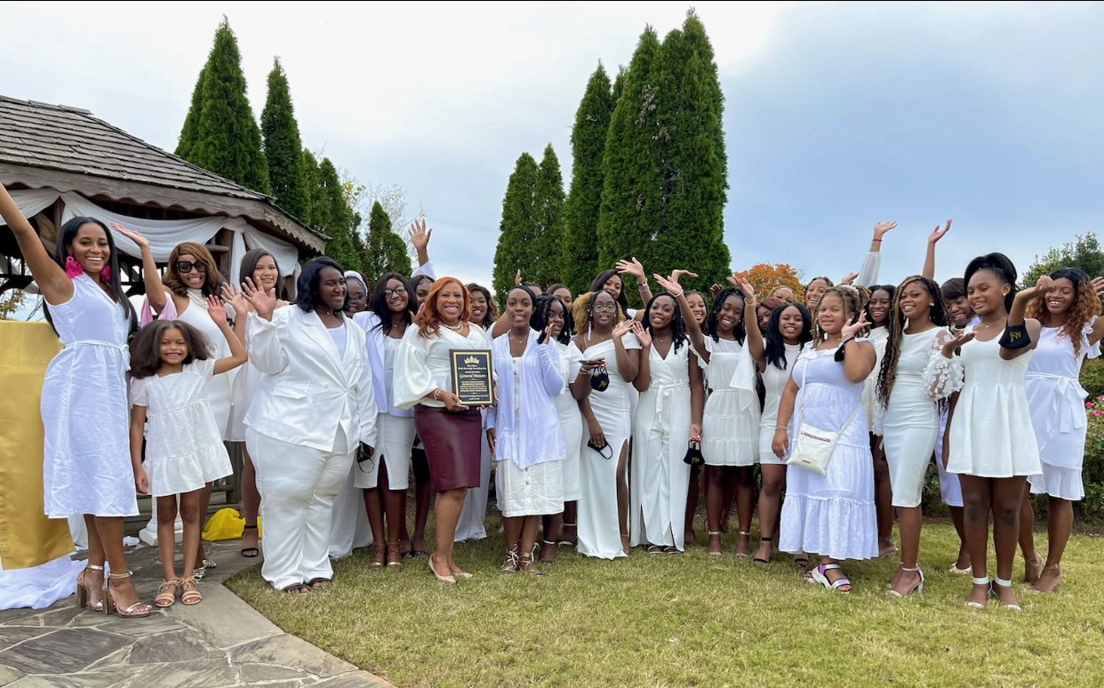
References ➔
  Rockdale County Public Schools Mentor Coordinator Handbook, 2012-2013
  Mentor.org
Missingkids.org
Third Party Statistics - National Runaway Safeline | National Runaway Safeline (1800runaway.org
  Merriam-Webster Dictionary
  Wikipedia, The Free Encyclopedia
  CDC.GOV
  https://www.cdc.gov/mmwr/volumes/69/wr/mm6914e4.htm
  https://www.cdc.gov/coronavirus/2019-ncov/daily-life-coping/children/symptoms.html
@FirstLadiesFdn

